Slide 1
DATA ANALYSIS

Slide 2
Exploratory Data Analysis (EDA): ref:EDA.py
Exploratory Data Analysis (EDA) is an approach to analyzing the data using visual techniques.
It is used to discover trends, and patterns, or to check assumptions with the help of statistical summary and graphical representations.
TYPES OF EXPLORATORY DATA ANALYSIS:
Univariate non-graphical (uses 1 variable)
Multivariate non-graphical (Uses 1 or more variables to find the relation)
Univariate graphical
Multivariate graphical
TOOLS REQUIRED FOR EXPLORATORY DATA ANALYSIS:
R language
Python
Note: Apart from the above functions, EDA also performs K-Means Clustering

Slide 3
Data Visualization:
Data Visualization is the process of analyzing data in the form of graphs or maps.
Which makes us a lot easier to understand the trends or patterns in the data.
Types of visualizations techniques:
Univariate analysis: (Deals with only one variable)
Bi-Variate analysis: (Deals with two variables)
Multi-Variate analysis: (Deals with 3 or more variables)

Slide 4
Elements of Structured Data :
Data comes from many sources: sensor measurements, events, text, images, and videos.
And nowadays IoT is playing a significant role in collecting DATA. Through which data is UNSTRUCTURED.
In fact, a significant challenge of data science is to harness this torrent of raw data into actionable information.
So, the collected, unstructured raw data must be processed and manipulated into a structured form — as it might emerge from a relational database — or be collected for a study.

Slide 5
Type of Data:
There are two basic types of structured data:
numeric
categorical.
Numeric data comes in two forms:
continuous, such as wind speed or time duration, and discrete, such as the count of the occurrence of an event. Categorical data takes only a fixed set of values, such as a type of TV screen (plasma, LCD, LED, etc.) or a state name (Alabama, Alaska, etc.).
Binary data is an important special case of categorical data that takes on only one of two values, such as 0/1, yes/no, or true/false.
categorical data is ordinal data in which the categories are ordered; an example of this is a numerical rating (1, 2, 3, 4, or 5).

Slide 6
Numeric
Data that are expressed on a numeric scale.
Continuous
Data that can take on any value in an interval. (Synonyms: interval, float, numeric)
Discrete
Data that can take on only integer values, such as counts. (Synonyms: integer, count)
Categorical
Data that can take on only a specific set of values representing a set of possible
categories. (Synonyms: enums, enumerated, factors, nominal)
Binary
A special case of categorical data with just two categories of values, e.g., 0/1,
true/false. (Synonyms: dichotomous, logical, indicator, boolean)
Ordinal
Categorical data that has an explicit ordering. (Synonym: ordered factor)

Slide 7
Why do we bother with a taxonomy of data types?
The purposes of data analysis and predictive modeling is that,
The data type is important to help to determine the type of visual display, data analysis, or statistical model.
Data science software, such as R and Python, uses these data types to improve computational performance.
The data type for a variable determines how the software will handle computations for that variable.
Software engineers and database programmers may wonder why we even need the notion of categorical and ordinal data for analytics.

Slide 8
KEY IDEA:
Data is typically classified in software by type.
Data types include continuous, discrete, categorical (which includes binary), and ordinal.
Data typing in software acts as a signal to the software on how to process the data.

Slide 9
Rectangular Data
The typical frame of reference for analysis in data science is a rectangular data object, like a spreadsheet or database table.
Rectangular data is essentially a two-dimensional matrix with rows indicating records (cases) and columns indicating features (variables).

Slide 10
Key Terms for Rectangular Data
Data frame
Rectangular data (like a spreadsheet) is the basic data structure for statistical and
machine learning models.
Feature
A column within a table is commonly referred to as a feature.
Synonyms
attribute, input, predictor, variable
Outcome
Many data science projects involve predicting an outcome—often a yes/no outcome
(in Table 1-1, it is “auction was competitive or not”). The features are sometimes
used to predict the outcome in an experiment or a study.
Synonyms
dependent variable, response, target, output
Records
A row within a table is commonly referred to as a record.
Synonyms
case, example, instance, observation, pattern, sample

Slide 11
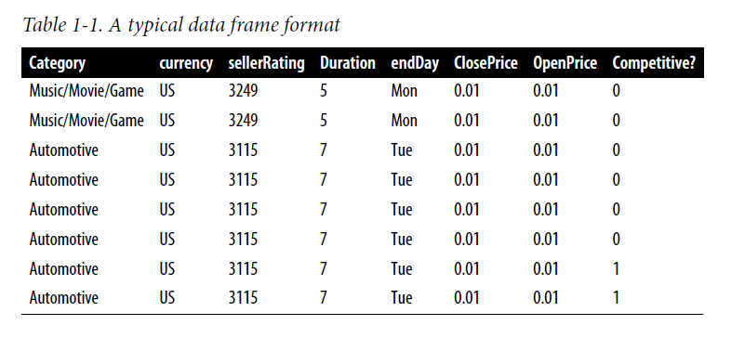

Slide 12
Estimates of Location (MEAN)
Variables with measured or count data might have thousands of distinct values.
A basic step in exploring our data is getting a “typical value” for each feature (variable):
Nothing but an estimate of where most of the data is located (i.e., its central tendency).
While the mean is easy to compute and expedient to use, it may not always be the best measure for a central value.
Because of this statisticians have developed and promoted several alternative estimates to the mean.

Slide 13
Trimmed Mean: sorted values – and exclude the extreme values and find the mean.
Weighted Mean: Is calculated by multiplying each data value by a weight and dividing their sum by the sum of the weights.

Slide 14

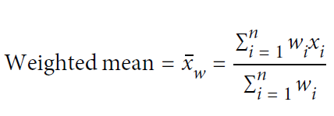
Key Terms for Estimates of Location
Mean
The sum of all values divided by the number of values.
Synonym
average
Weighted mean
The sum of all values times a weight divided by the sum of the weights.
Synonym
weighted average
Median
The value such that one-half of the data lies above and below.
Synonym
50th percentile
Percentile
The value such that P percent of the data lies below.
Synonym
quantile

Slide 15
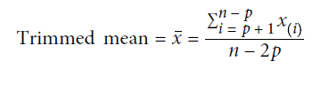
Weighted median
The value such that one-half of the sum of the weights lies above and below the
sorted data.
Trimmed mean
The average of all values after dropping a fixed number of extreme values.
Synonym
truncated mean
Robust
Not sensitive to extreme values.
Synonym
resistant
Outlier
A data value that is very different from most of the data.
Synonym
extreme value

Slide 16
state = pd.read_csv('state.csv')
state['Population'].mean()
trim_mean (state['Population'], 0.1)
state['Popnulation'].median()

Slide 17
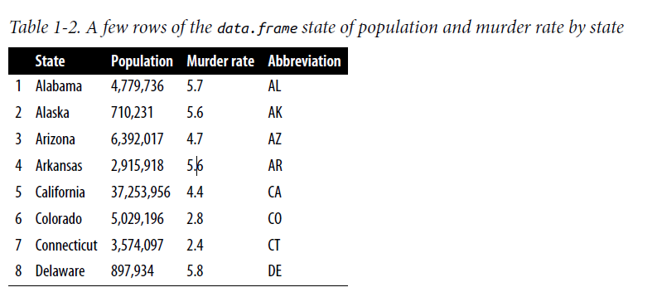

Slide 18
Estimates of Variability.
Location is just one dimension in summarizing a feature.
A second dimension, variability, also referred to as dispersion, measures whether the data values are tightly clustered or spread out.
All the statistics data are in variability: so we need to
measuring it, reducing it, distinguishing random from real variability, identifying the various sources of real variability, and making decisions.

Slide 19
Key Terms for Variability Metrics
Deviations
The difference between the observed values and the estimate of location.
Synonyms
errors, residuals
Variance
The sum of squared deviations from the mean divided by n – 1 where n is the
number of data values.
Synonym
mean-squared-error
Standard deviation
The square root of the variance.
Mean absolute deviation
The mean of the absolute values of the deviations from the mean.
Synonyms
l1-norm, Manhattan norm

Slide 20
Median absolute deviation from the median
The median of the absolute values of the deviations from the median.
Range
The difference between the largest and the smallest value in a data set.
Percentile
The value such that P percent of the values take on this value or less and (100–P)
percent take on this value or more.
Synonym
quantile
Interquartile range
The difference between the 75th percentile and the 25th percentile.
Synonym
IQR

Slide 21

Standard Deviation and Related Estimates
The most widely used estimates of variation are based on the differences,
or deviations, between the estimate of location and the observed data.
For a set of data {1, 4, 4},
the mean is 3 and the median is 4.
The deviations from the mean are the differences: 1 – 3 = –2, 4 – 3 = 1, 4 – 3 = 1.
In the preceding example, the absolute value of the deviations
is {2 1 1}, and their average is (2 + 1 + 1) / 3 = 1.33. This is known as the mean
absolute deviation and is computed with the formula:

Slide 22
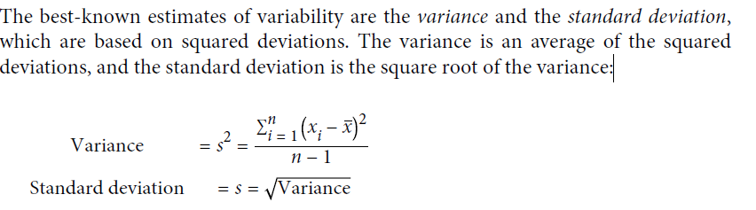

Slide 23

Neither the variance, the standard deviation, nor the mean absolute deviation is robust to outliers and extreme values
The variance and standard deviation are especially sensitive to outliers since they are based on the squared deviations.
A robust estimate of variability is the median absolute deviation from the median or MAD:

Slide 24
Exploring Binary and Categorical Data
For categorical data, simple proportions or percentages tell the story of the data.
Ex: how frequently the certain category of event is occurring. Which is represented in bar charts of box plots.

Slide 25
Key Terms for Exploring Categorical Data
Mode
The most commonly occurring category or value in a data set.
Expected value
When the categories can be associated with a numeric value, this gives an average value based on a category’s probability of occurrence.
Bar charts
The frequency or proportion for each category plotted as bars.
Pie charts
The frequency or proportion for each category plotted as wedges in a pie.

Slide 26
Correlation.
Exploratory data analysis in many modeling projects (whether in data science or in research) involves examining correlation among predictors, and between predictors and a target variable.

Slide 27
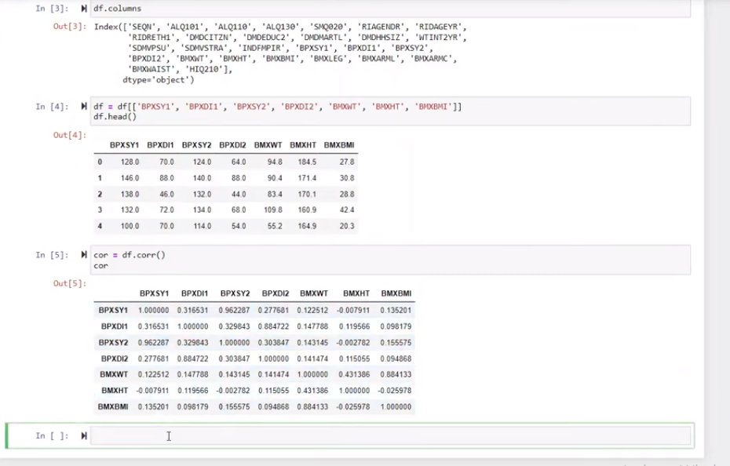

Slide 28
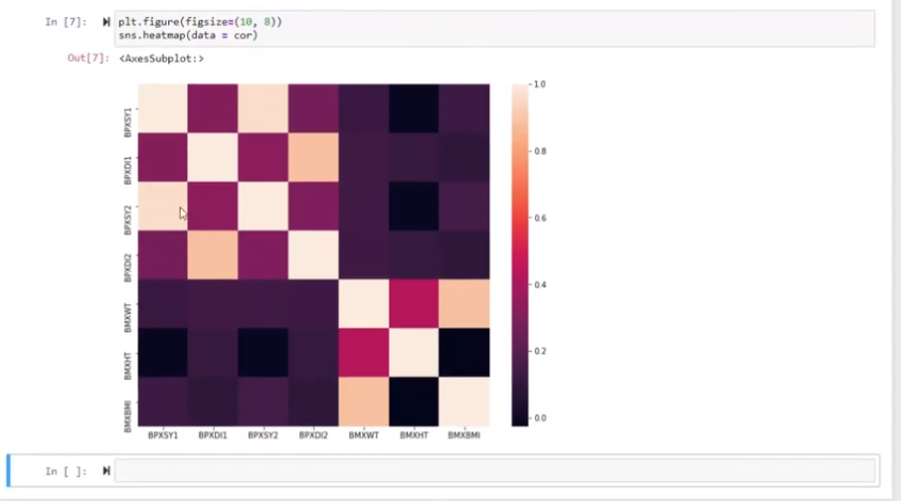

Slide 29
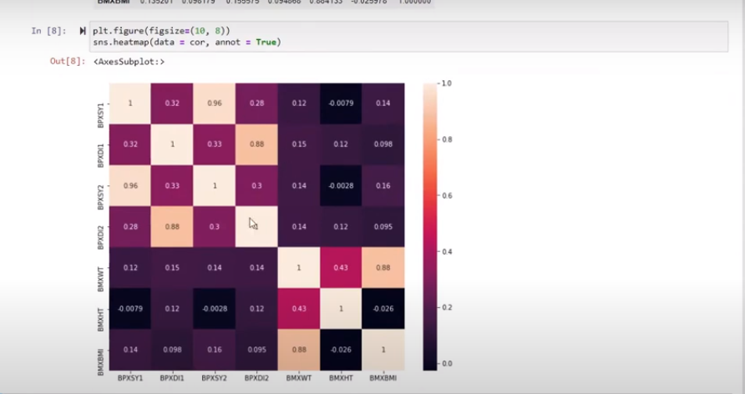

Slide 31
Key Terms for Correlation
Correlation coefficient
A metric that measures the extent to which numeric variables are associated with one another (ranges from –1 to +1).
Correlation matrix
A table where the variables are shown on both rows and columns, and the cell values are the correlations between the variables.
Scatterplot
A plot in which the x-axis is the value of one variable, and the y-axis the value of another.

Slide 32
Exploring Two or More Variables.(Multivariate)
Mean and variance look at variables one at a time (univariate analysis).
Correlation analysis (see “Correlation”) is an important method that compares two variables (bivariate analysis).
Like univariate analysis, bivariate analysis involves both computing summary statistics and producing visual displays.
The appropriate type of bivariate or multivariate analysis depends on the nature of the data: numeric versus categorical.

Slide 33
Data and Sampling Distributions
There was a misconception that Data Sampling is unnecessary upon the introduction of BIG DATA and BIG DATA ANALYSIS.
What is Big Data?
Data that contains greater variety, arriving in increasing volumes and with more velocity.
What is Big Data Analysis?
It is the use of advanced analytic techniques against very large, diverse data sets that include structured, semi-structured, and unstructured data, from different sources.
In fact, the proliferation of data of varying quality and relevance reinforces the need for sampling as a tool to work efficiently with a variety of data and to minimize bias.
Samples are also used in tests of various sorts, like in pricing, or in web usage, etc.

Slide 34
Random Sampling and Sample Bias
A sample is a subset of data from a larger data set;
statisticians call this larger data set the population.
Random Sampling: Random sampling is a process in which each available member of the population being sampled has an equal chance of being chosen for the sample at each draw.
The sample that results is called a simple random sample.
Sampling can be done with replacement, in which observations are put back in the population after each draw for possible future reselection. Or it can be done without replacement, in which case observations, once selected, are unavailable for future draws.

Slide 35
Bias
Statistical bias refers to measurement or sampling errors that are systematic and produced by the measurement or sampling process.

Slide 36
Random Selection(Random Sampling)
To avoid the problem of sample bias, random selection is used.
Ex: Supermarket customer analysis.
Parameters to choose: Do we include all past customers?
Do we include refunds?
Internal test purchases?
Resellers?
Both billing agent and customer?

Slide 37
Size versus Quality:
When Does Size Matter? (small sample to avoid bias)
When does Quality matter? (out of large data, select a small sample)
Ex: Discuss an example of feedback from the students.

Slide 38
The Bootstrap
One easy and effective way to estimate the sampling distribution of a statistic, or of model parameters, is to draw additional samples, with replacement, from the sample itself and recalculate the statistic or model for each resample.
This procedure is called the bootstrap, and it does not necessarily involve any assumptions about the data or the sample statistic being normally distributed.

Slide 39
Algo for Bootstrap:(for a sample of size n)
Draw a sample value, record, and replace it.
Repeat n times.
Record the mean of the n resampled values.
Repeat steps 1–3 R times.
Use the R results to:
Calculate their standard deviation (this estimates sample mean standard error).
Produce a histogram or boxplot.
Find a confidence interval.
R: is a number of iterations.
Note: more the iteration, the more accurate is the result.

Slide 40
Resampling vs Bootstrapping

Slide 41
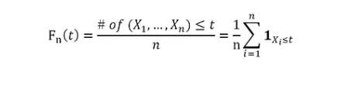
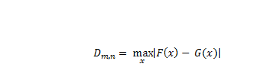

Slide 42
ANOVA TEST: (Analysis of Variance)
When we wanted to compare more than two population means, we use ANOVA.
With the t-test, we can graphically get an idea of what is going on by looking at side-by-side boxplots, if the population is small or the number of comparisons is small.

Slide 43
Basic ANOVA concepts
we consider a quantitative response variable as it relates to one or more explanatory variables, usually categorical.
Ex: (i) Which academic department in the sciences gives out the lowest average grades?
(Explanatory variable: department; Response variable: student GPAs for individual courses)
(ii) Which kind of promotional campaign leads to the greatest store income at Christmas time?
(Explanatory variable: promotion type; Response variable: daily store income)
(iii) How does the type of career and marital status of a person relate to the total cost in annual claims she/he is likely to make on her health insurance.
(Explanatory variables: career and marital status; Response variable: health insurance payouts)

Slide 44
Hypotheses of ANOVA
These are always the same.
H0: The (population) means of all groups under consideration are equal.
Ha: The (pop.) means are not all equal.
(Note: This is different than saying “they are all unequal ”!)

Slide 45
Assumptions of ANOVA
ANOVA has some underlying assumptions which should be in place in order to make the results of calculations completely trustworthy.
(i) Subjects are chosen via a simple random sample.
(ii) Within each group/population, the response variable is normally distributed.
(iii) While the population means may be different from one group to the next, the population standard deviation is the same for all groups.
Note: ANOVA is somewhat robust (i.e., results remain reasonably trustworthy despite mild violations of these assumptions).
Assumptions (ii) and (iii) are close enough to be true.
We have 2 types of ANOVA tests: one-way and two-way test

Slide 46
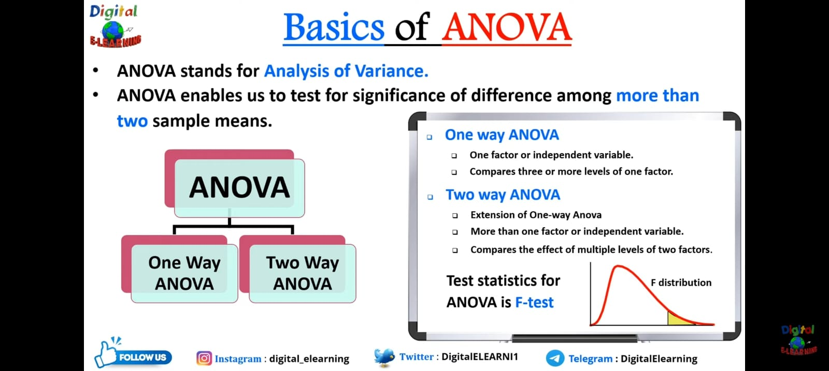

Slide 47
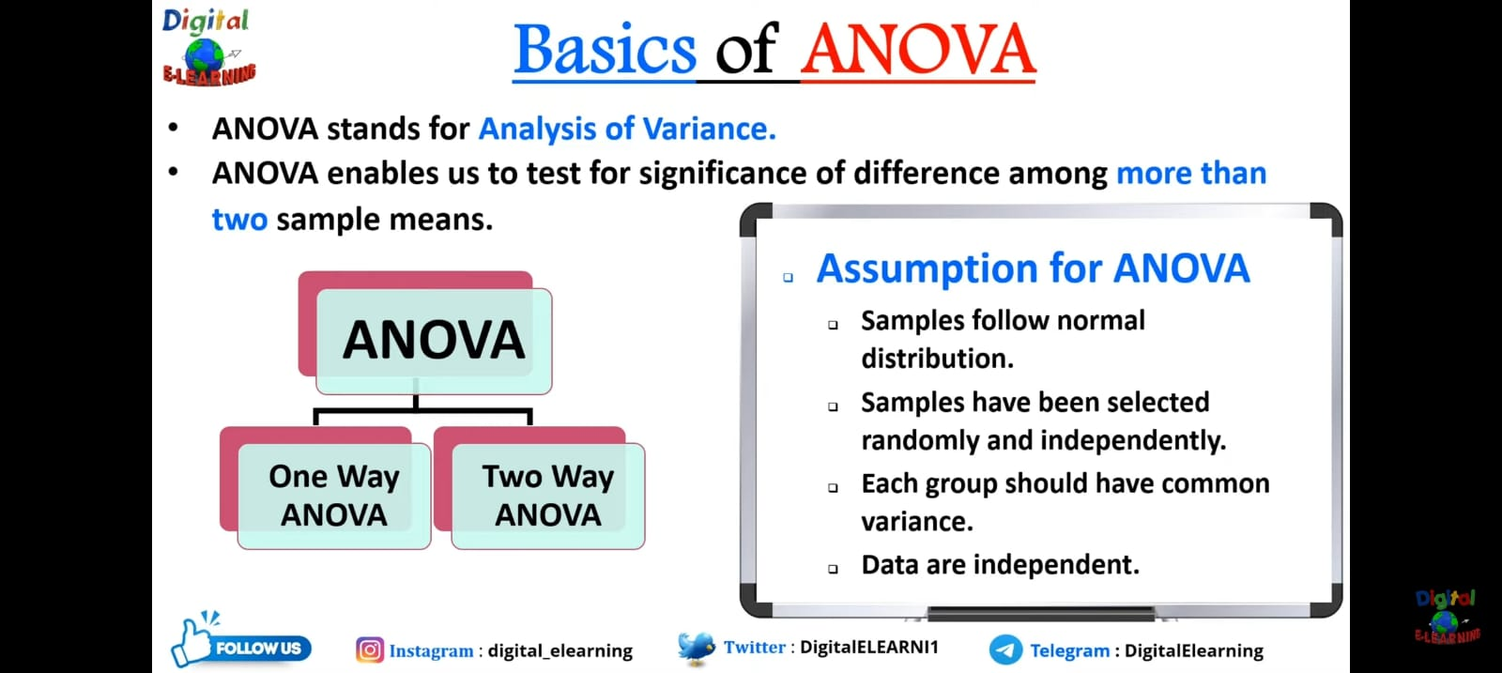

Slide 48
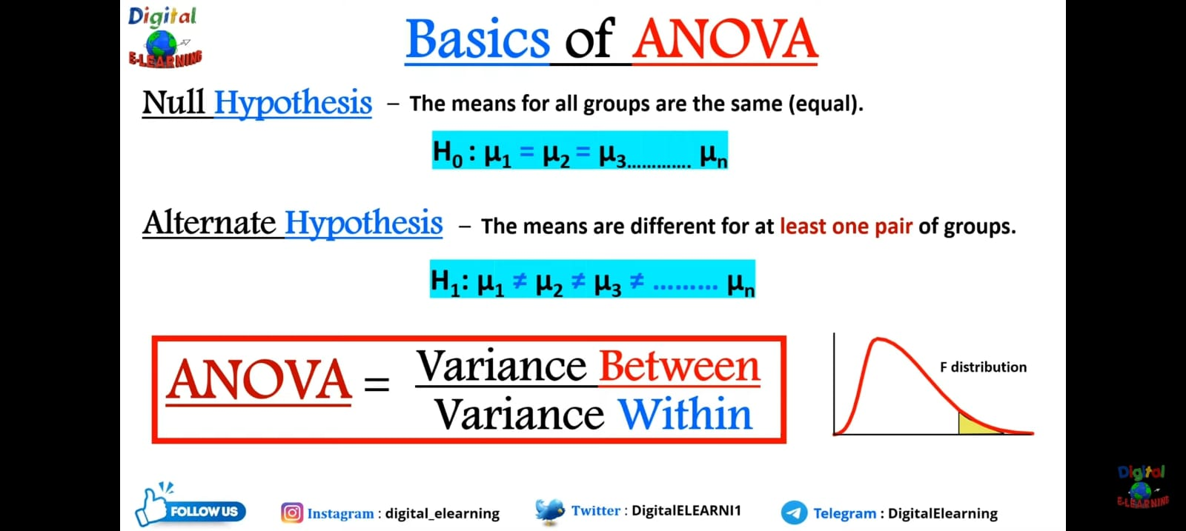

Slide 49
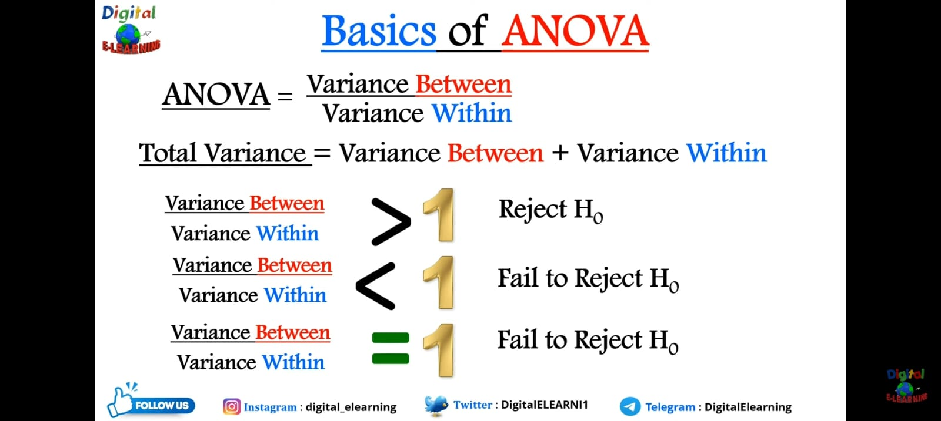

Slide 50
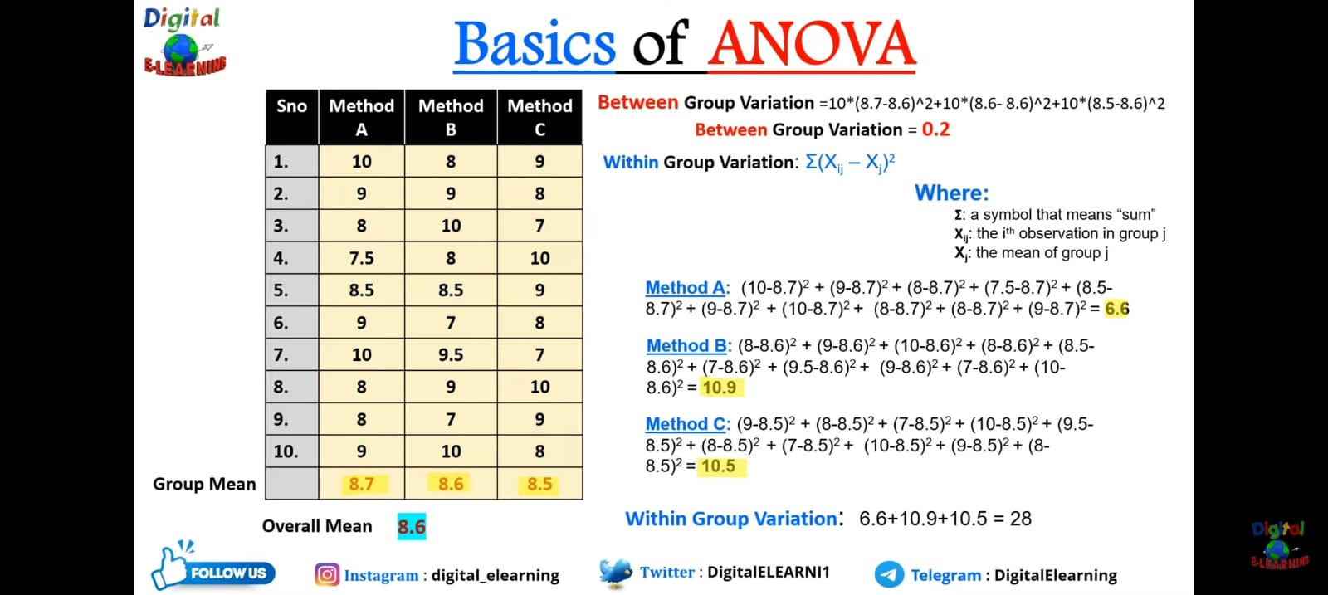

Slide 51
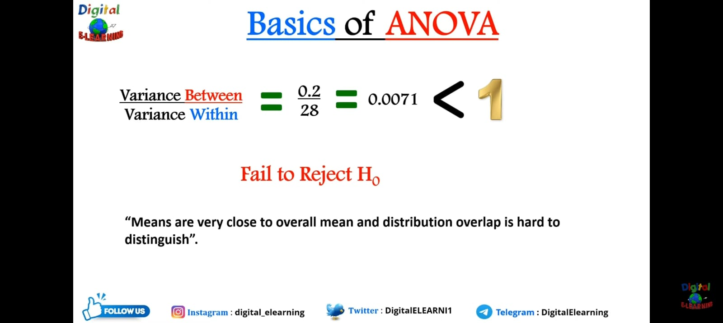

Slide 52
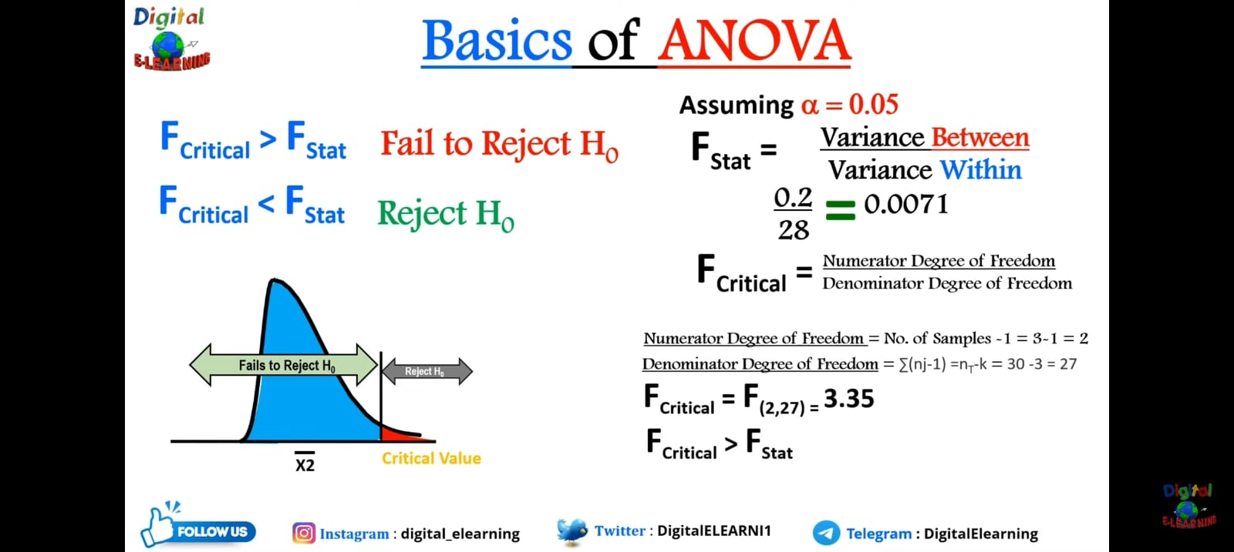

Slide 53
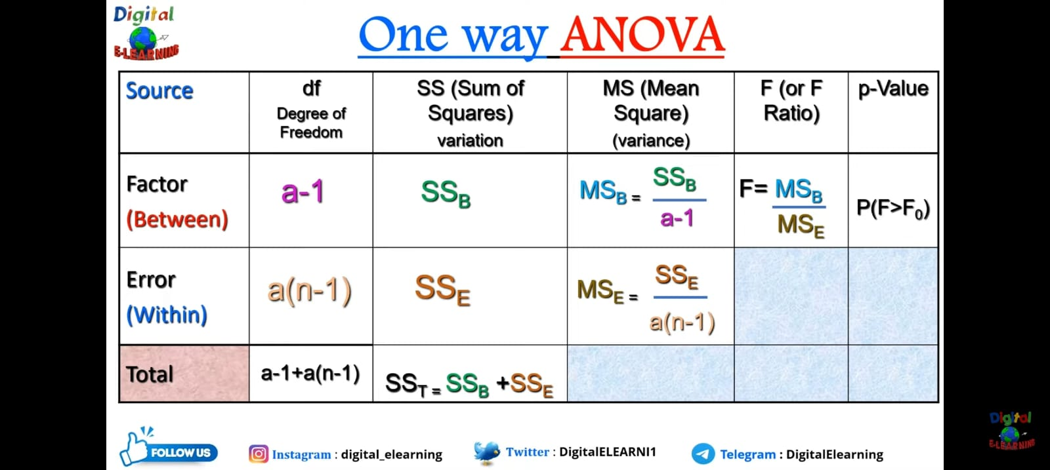

Slide 54


Slide 55
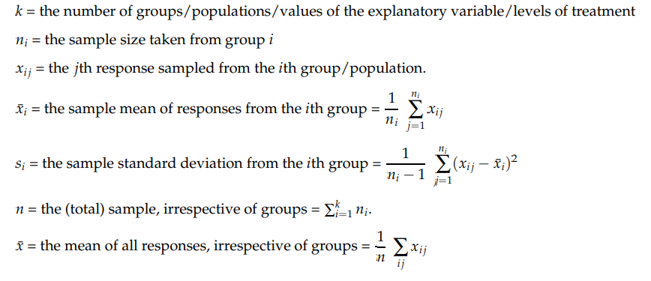
One-Way ANOVA:
When there is just one explanatory variable, we refer to the analysis of variance as one-way ANOVA.
Notations:

Slide 56
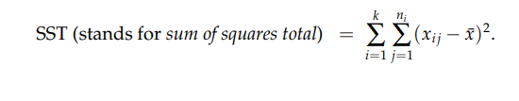
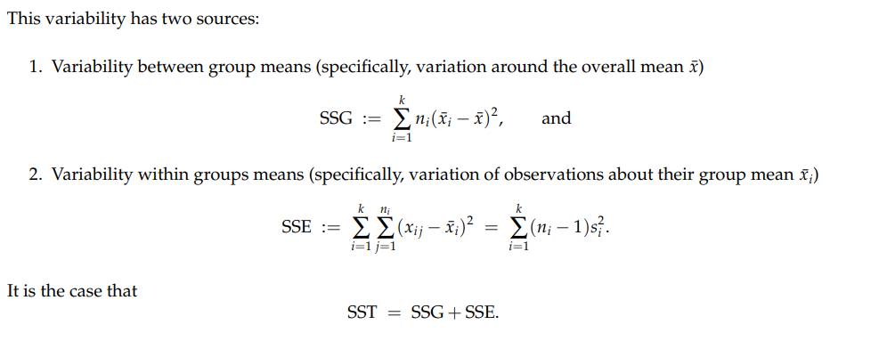
Splitting the Total Variability into Parts
Viewed as one sample, one might measure the total amount of variability among observations by summing the squares of the differences between each x_{i j} and x¯:

Slide 57
The Calculations:
If the variability between groups/treatments is large relative to the variability within groups/treatments, then the data suggest that the means of the populations from which the data were drawn are significantly different.
i.e., how the F statistic is computed:
F=(it is a measure of the variability between treatments)/(a measure of the variability within treatments).
If F is large, the variability between treatments is large relative to the variation within treatments, and we reject the null hypothesis of equal means.
If F is small, the variability between treatments is small relative to the variation within treatments, and we do not reject the null hypothesis of equal means.
(Note: In small cases, the sample data is consistent with the hypothesis that population means are equal between groups.)

Slide 58
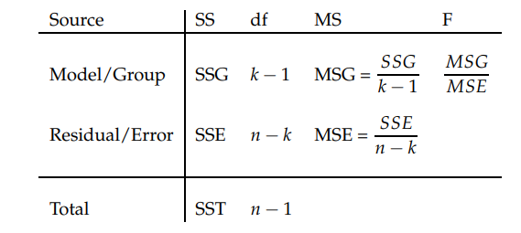
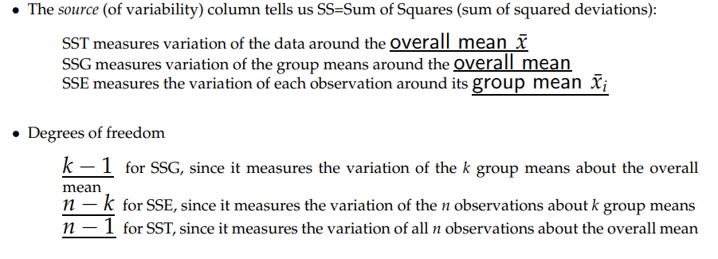
ANOVA Table:
MS = Mean Square = SS/df
The F statistic = MSG/MSE
Note: If the null hypothesis is true, the F statistic has an F distribution with k − 1 and n − k degrees of freedom in the numerator/denominator respectively. If the alternate hypothesis is true, then F tends to be large. We reject H0 in favor of Ha if the F statistic is sufficiently large.

Slide 59
